Slide 1
Processors
Advanced Computer Architecture

Slide 2
Agenda
Modern processor technology
  Instruction set architectures (CISC vs RISC)
  Typical processors: superscalar, VLIW, superpipelined and vector

Slide 3
Processors
Advanced Processor Technology
  Design Space of Processors
  Instruction-Set Architectures
  CISC Scalar Processors
  RISC Scalar Processors
Superscalar and Vector Processors
  Superscalar Processors
  VLIW Architecture
  Vector and Symbolic Processors

Slide 4
Design space of processors
Mapping processor families onto a coordinated space of
clock rate vs cycles per instruction (CPI)
Trends:-
  Clock rates are moving from low to high
  (implementation technology)
  Lowering CPI rate
  (hardware and software approaches)

Slide 5
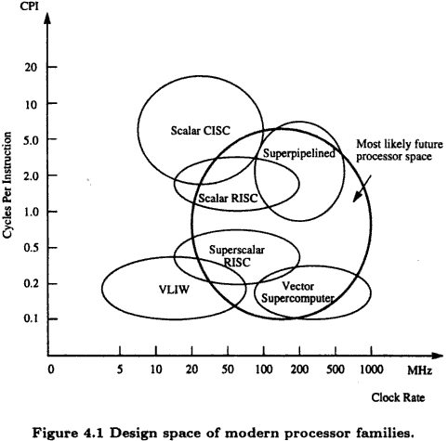
Conventional processors like Intel i486, M68040, VAX/8600, IBM
390, etc fall into this family. Typical clock rate ~ 33 – 50 MHz and
With microprogrammed control, typical CPI ~ 1 - 20
Today’s RISC processors like Intel i860, SPARC, MIPS R3000, IBM RS/6000, etc. have faster clock rate ~ 20 – 120 MHz and with hardwired control, typical CPI ~ 1 - 2
Special subclass of RISC processor (Superscalar processors) which allow multiple instructions to be issued during each cycle, thus taking CPI to a lower value with similar clock rate as that of RISC
Very Long Instruction Word (VLIW) architecture uses even more functional units than superscalar, thus its CPI is further low, but due to long instructions (microprogrammed), its clock rate is slow
Superpipelined processors have higher clock rate ~ 100 – 500 MHz, however CPI is also high unless there is use of multiple functional units as in the case of vector supercomputers
Source: Kai Hwang

Slide 6
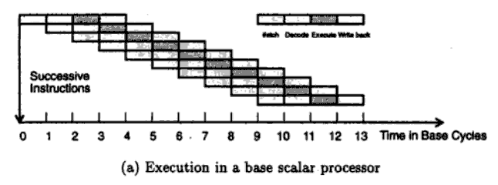
Instruction Pipeline
Typical instruction execution involves four phases: fetch, decode, execute & write-back
Often executed by instruction pipeline
Source: Kai Hwang

Slide 7
Definitions (instruction pipeline)
Instruction pipeline cycle – clock period of the instruction pipeline
Instruction issue latency – time (cycles) required between issuing of two adjacent instructions
Instruction issue rate – number of instructions issued per cycle

Slide 8
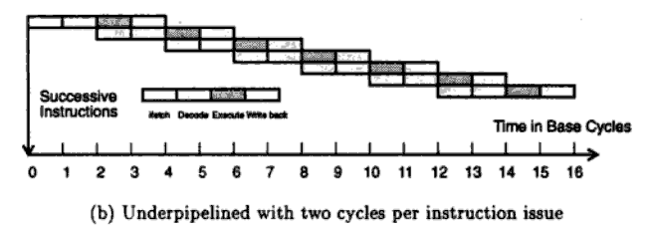
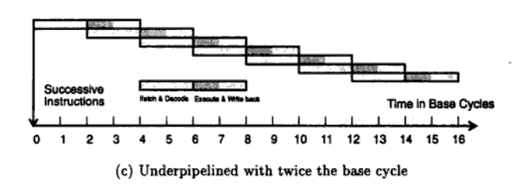
Instruction issue latency:
one instruction issued every two cycles
Pipeline cycle time:
doubled by combining pipeline stages
Source: Kai Hwang

Slide 9
Processors & Coprocessors
Central processor of computer is called CPU
  Scalar processor
  Multiple functional units
  Floating point accelerator
Floating point unit can be coprocessor
  Attached with CPU
  Executes instructions dispatched by CPU
  Can’t be used alone, can’t handle I/O operations

Slide 10
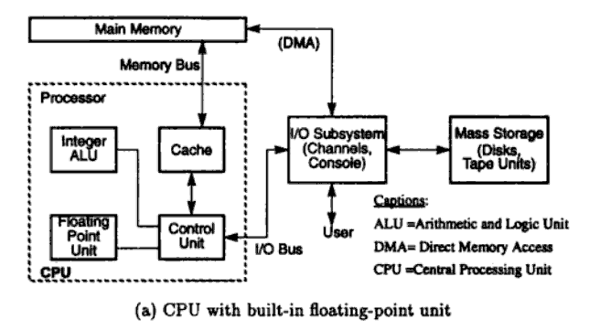
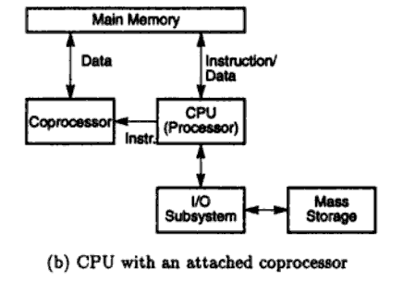
Source: Kai Hwang

Slide 11
Processors
Advanced Processor Technology
  Design Space of Processors
  Instruction-Set Architectures
  CISC Scalar Processors
  RISC Scalar Processors
Superscalar and Vector Processors
  Superscalar Processors
  VLIW Architecture
  Vector and Symbolic Processors

Slide 12
Instruction Set Architectures
Instruction set, defines the primitive commands or machine instructions
Characteristics of instruction set:-
  Instruction formats
  Data formats
  Addressing modes
  General purpose registers
  Opcode specifications
  Flow control mechanisms
Two approaches: CISC and RISC

Slide 13
Complex Instruction Set Computing (CISC)
Add more and more functions into the hardware, thereby making instruction set very large & complex
Characterized by microprogrammed control
Typical CISC contains 120 – 350 instructions
Uses a small set of 8 – 24 general purpose registers
Large number of memory reference instructions
More than a dozen addressing modes
HLL statements directly implemented in hardware
Improve execution efficiency

Slide 14
Reduced Instruction Set Computing (RISC)
Only 25% of large set of instructions used frequently 95% of the time → 75% of hardware supported functions not used
Why use valuable hardware which is rarely used ?
Push all these rare instructions to software, only frequently used instructions are done by hardware
Characterized by hardwired control
Typical RISC contains less than 100 instructions
Fixed instruction format (32 bit)
Large general purpose registers, most instructions are register based
Memory access only by load/store instructions
Only 3 – 5 addressing modes

Slide 15
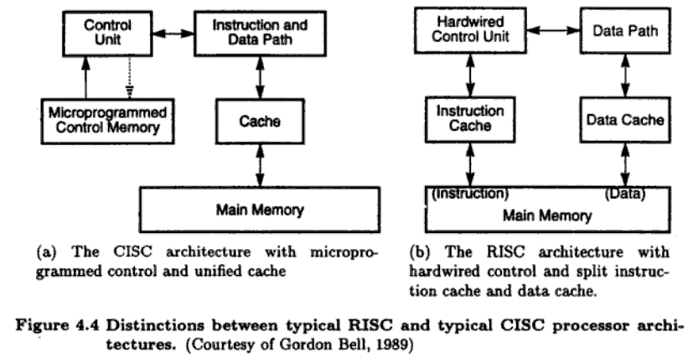
CISC vs RISC Architectures
Source: Kai Hwang

Slide 16
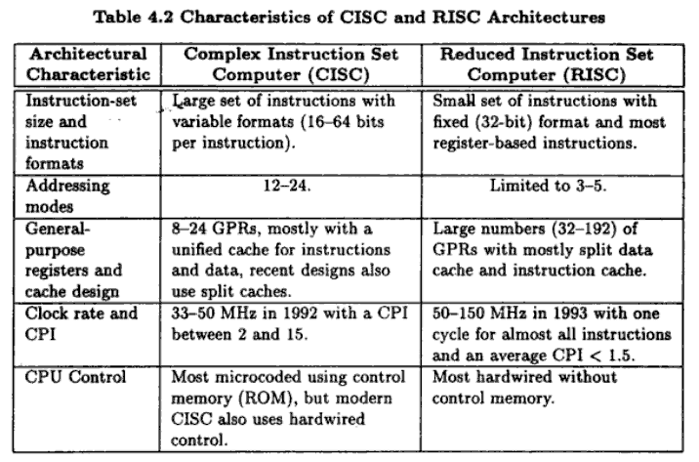
Source: Kai Hwang

Slide 17
CISC Scalar Processor
Scalar processor executes with scalar data
  Simple models work with integer instructions using fixed point operands
  Complex models work with integer and floating point operations
Both integer unit and floating point unit may be present in same CPU
Ideally, its performance should be that of instruction pipeline with one instruction fed per clock cycle
Practically, it works in underpipelined situation due to data dependencies, resource conflicts, branch penalties, etc.

Slide 18
Design Philosophy - CISC
1. Implement useful instructions in hardware, resulting in shorter program length and lower software overhead
2. However, this is achieved at the expense of lower clock rate and higher CPI
Balance between the two required !

Slide 19
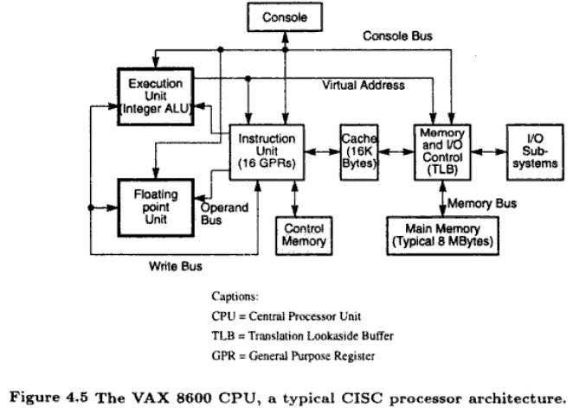
Example 1
Typical CISC architecture with
Microprogrammed control
Instruction set contains 300
instructions with 20 different
addressing modes
CPU consist of two functional
units for execution of floating
point and integer instructions
Unified cache holds both
instructions and data
16 GPRs in instruction unit and Instruction
pipelining has six stages
Source: Kai Hwang

Slide 20
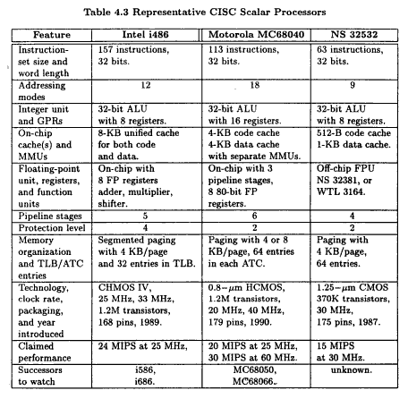
General characteristics
Large number of
instructions
More options in the
addressing modes
Lower clock rate
High CPI
Widely used in personal
computer (PC) industry
Source: Kai Hwang

Slide 21
Processors
Advanced Processor Technology
  Design Space of Processors
  Instruction-Set Architectures
  CISC Scalar Processors
  RISC Scalar Processors
Superscalar and Vector Processors
  Superscalar Processors
  VLIW Architecture
  Vector and Symbolic Processors

Slide 22
RISC Scalar Processor
Generic RISC processors are called scalar RISC because they are designed to issue one instruction per cycle
RISC processors push some of the less frequently used operations into software
RISC processors depend heavily on a good compiler because complex HLL instructions are to be converted into primitive low level instructions, which are few in number
RISC processors have a higher clock rate and lower CPI

Slide 23
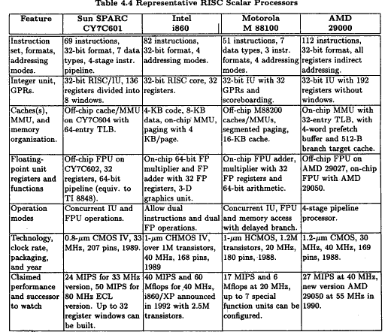
General characteristics
All use 32-bit
instructions
Instruction set
consist of less than
100 instructions
High clock rate
Low CPI
Source: Kai Hwang

Slide 24
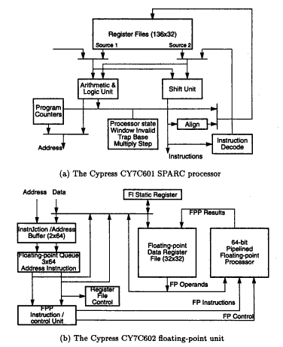
Example 1
SPARC stands for scalable processor
architecture
Scalability is due to use of number of
register windows
(explained on next slide)
Floating point unit (FPU) is
implemented on a separate chip
Source: Kai Hwang

Slide 25
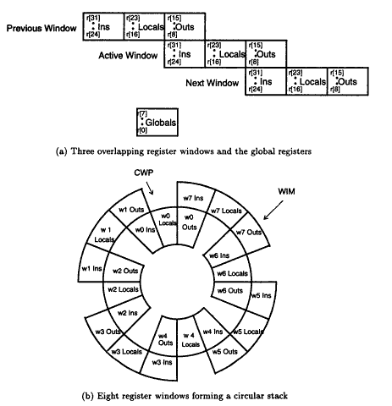
Window Registers
SPARC runs each procedure with a
set of thirty two 32-bit registers
Eight of these registers are global
registers shared by all procedures
Remaining twenty four registers
are window registers associated with
only one procedure
Concept of using overlapped
registers is the most important
feature introduced
Each register window is divided into
three sections – Ins, Locals and Outs
Locals are addressable by each procedure and Ins & Outs are shared among
procedures
Source: Kai Hwang

Slide 26
Processors
Advanced Processor Technology
  Design Space of Processors
  Instruction-Set Architectures
  CISC Scalar Processors
  RISC Scalar Processors
Superscalar and Vector Processors
  Superscalar and Vector Processors
  VLIW Architecture
  Vector and Symbolic Processors

Slide 27
“Scalar” vs “Superscalar” Processors
Scalar processors:-
  Execute one instruction per cycle
  One instruction is issued per cycle
  Pipeline throughput: one instruction per cycle
Superscalar processors:-
  Multiple instruction pipelines used
  Multiple instruction issued per cycle and
  Multiple results generated per cycle

Slide 28
Superscalar Processors
Designed to exploit instruction-level parallelism in user programs
Amount of parallelism depends on the type of code being executed
On average, at instruction level around 2 instructions can be executed in parallel
There is no benefit to have a processor which can be fed with 3 instructions per cycle
Thus, instruction-issue degree in superscalar has been limited to 2 – 5

Slide 29
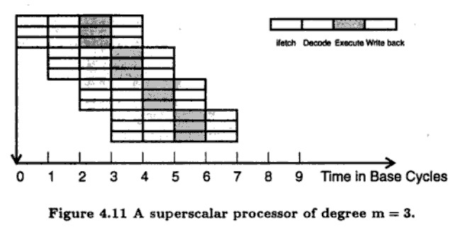
Pipelining in Superscalar Processors
A superscalar processor of
degree m can issue m
instructions per cycle
To fully utilize, at every
cycle, there must be m
instructions for execution
Dependence on compilers
is very high
Figure depicts three
instruction pipeline
Source: Kai Hwang

Slide 30
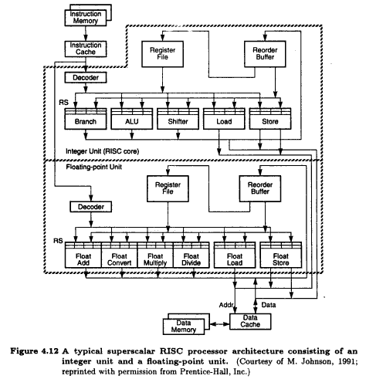
Example 1
A typical superscalar
architecture
Multiple instruction pipelines
are used, instruction cache
supplies multiple instructions per
fetch
Multiple functional units are
built into integer unit and floating
point unit
Multiple data buses run though
functional units, and in theory, all
such units can be run simultaneously
Source: Kai Hwang

Slide 31
Processors
Advanced Processor Technology
  Design Space of Processors
  Instruction-Set Architectures
  CISC Scalar Processors
  RISC Scalar Processors
Superscalar and Vector Processors
  Superscalar and Vector Processors
  VLIW Architecture
  Vector and Symbolic Processors

Slide 32
Very Large Word Instruction (VLIW) Architectures
Typical VLIW architectures have instruction word length of hundreds of bits
Built upon two concepts, namely
  1. Superscaler processing
    Multiple functional units work concurrently
    Common large register file is shared
  2. Horizontal microcoding
    Different fields of the long instruction word carries opcodes to be dispatched to multiple functional units
    Programs written in conventional short opcodes are to be converted into VLIW format by compilers

Slide 33
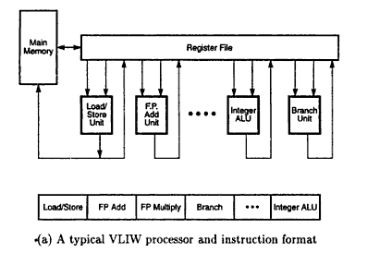
Typical VLIW Architecture
Multiple functional units
are concurrently used
All functional units use
the same register file
* A typical instruction format
Source: Kai Hwang

Slide 34
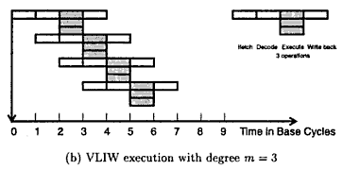
Pipelining in VLIW Architecture
Each instruction in VLIW
architecture specifies multiple
instructions
Execute stage has multiple
operations
Instruction parallelism and data
movement in VLIW architecture
are specified at compile time
CPI of VLIW architecture is lower than superscalar processor
Source: Kai Hwang

Slide 35
Processors
Advanced Processor Technology
  Design Space of Processors
  Instruction-Set Architectures
  CISC Scalar Processors
  RISC Scalar Processors
Superscalar and Vector Processors
  Superscalar and Vector Processors
  VLIW Architecture
  Vector and Symbolic Processors

Slide 36
Vector Processors
Vector processor is a coprocessor designed to perform vector computations
Vector computations involve instructions with large array of operands
  Same operation is performed over an array of operands
Vector processor may be designed with :-
  Register to register architecture
    Involves vector register files
  Memory to memory architecture
    Involves memory addresses

Slide 37
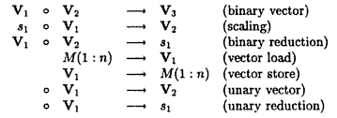

Vector Instructions
Register-based instructions
Memory-based instructions
V_{i} represent vector register
of length n
s_{i} represent scalar register
of length n
M(1:n) represent memory
array of length n
Source: Kai Hwang

Slide 38
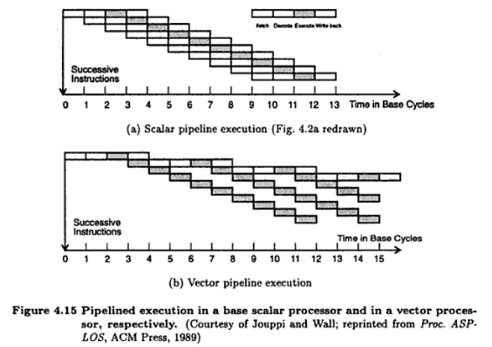
Vector Pipelines
Scalar pipeline
Each “Execute-Stage”
operates upon a scalar
operand
Vector pipeline
Each “Execute-Stage”
operates upon a vector
operand
Source: Kai Hwang

Slide 39
Symbolic Processors
Applications in the areas of pattern recognition, expert systems, artificial intelligence, cognitive science, machine learning, etc.
Symbolic processors differ from numeric processors in terms of:-
  Data and knowledge representations
  Primitive operations
  Algorithmic behavior
  Memory
  I/O communication

Slide 40
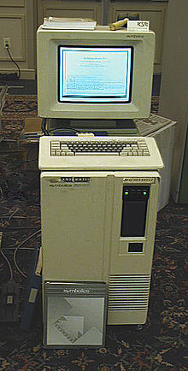
Symbolics 3640 Lisp machine

Slide 41
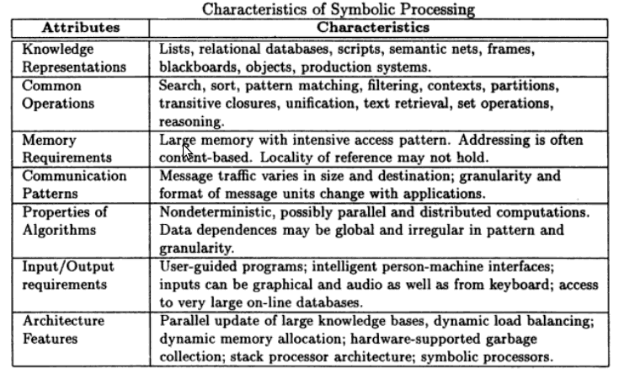
Characteristics
Source: Kai Hwang

Slide 42
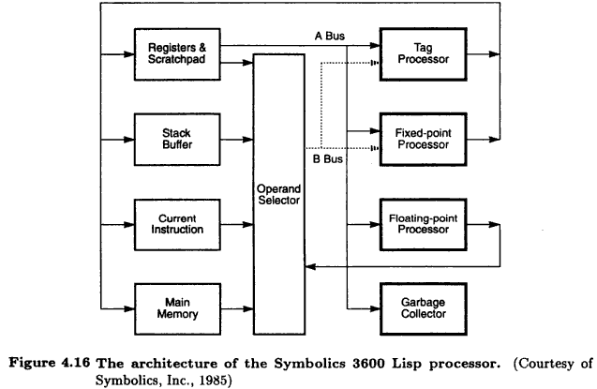
Example
Symbolic Lisp Processor
Multiple processing units
are provided which can
work in parallel
Operands are fetched
from scratch pad or stack
Processor executes most
of the instructions in single
machine cycle
Source: Kai Hwang

Slide 43
https://www.youtube.com/watch?v=AkFi90lZmXA
https://www.youtube.com/watch?v=FaQa9INqZf8
https://www.youtube.com/watch?v=aYjGXzktatA
https://www.youtube.com/watch?v=1OukpDfsuXE

Slide 44
https://www.youtube.com/watch?v=UGuWEX7yHww

